Slide 1


An In-Line Real-Time “Dynamic” Bulk Density Meter

Slide 2

The Technology
The system includes a Bulk Solids Pump volumetric feeder with small material hopper on load cells and mounted in-line in the process
Above the feeder is an automated gate valve that receives material from the process
Normal operation material flows through the gate valve & feeder
Density is calculated by closing the gate valve
A weight reading is triggered at a specified level

Slide 3
The Technology (cont’d)
After obtaining a successful weight reading the valve is opened
Density (lbs/ft3) = Weight (lbs) / Volume (ft3)
The entire process is completed in seconds –
  In-Line
  Real-Time
Measurement as frequent as every 5 – 10 seconds

Slide 4
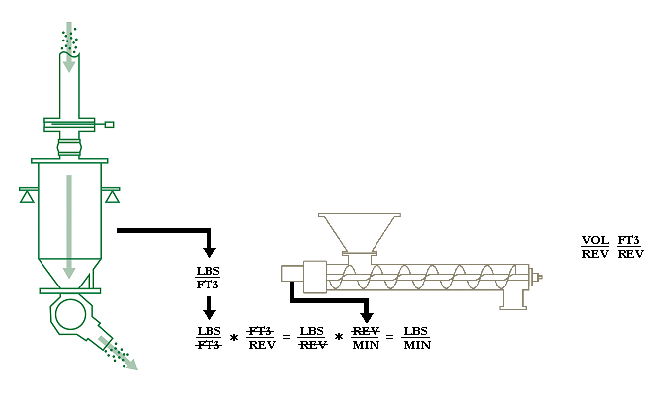

Add Intelligence
Dynamic Density as a Control Variable = Intelligent Volumetric
Add Density Measurement to Your Process System
Volumetric Metering Device Sized in Units
Signal Output
Speed Sensor
Integrates with:
Screw Conveyor
Rotary Valve
Vertical Auger
Feed Scalpel
Enabled For Intelligent Speed Modulation Based Upon Density Changes

Slide 5
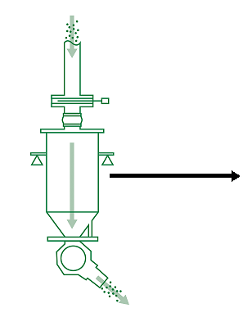
Sensor Function
Record Information
Periodic – Scheduled / On-Demand
Dynamic Density Measurement
History & Analytics
*Logged to Data Base
Situational Awareness
* Know Current Value
*Alarm If Outside Set Limits
*Quality Tracking
*Verify Raw Material
*Correct Material Used
Evaluate Data to Fuel Innovation
Output Signal (LBS/ FT3)

Slide 6
Spray Dryer Closed-Loop Control
The Density Meter is installed below a spray dryer to provide an in-line, real-time dynamic bulk density output.
The output is used as feedback to the spray dryer controls to optimize:
Bulk Density
Particle Size
Material Flowability

Slide 7
Dryer Control
The Density Meter is installed above a dryer to provide an in-line, real-time dynamic bulk density output.
The output is used as feed-forward to the dryer controls to improve drying time and reduce cost.

Slide 8
Blend Dissimilar Materials
The operator enters target density and line setpoint.
Each feeder receives an appropriate setpoint to ensure the packaging line receives the proper dynamic bulk density material and total line throughput.

Slide 9
Extruder / Feed System Control
Dynamic bulk density feedback is used to extruder or feed system parameters to control product quality.

